Slide 1
Bridging semantics and syntax with graph algorithms —state-of-the-art of extracting biomedical relations
Yuan Luo,O¨ zlem Uzuner and Peter Szolovits
160728

Slide 2
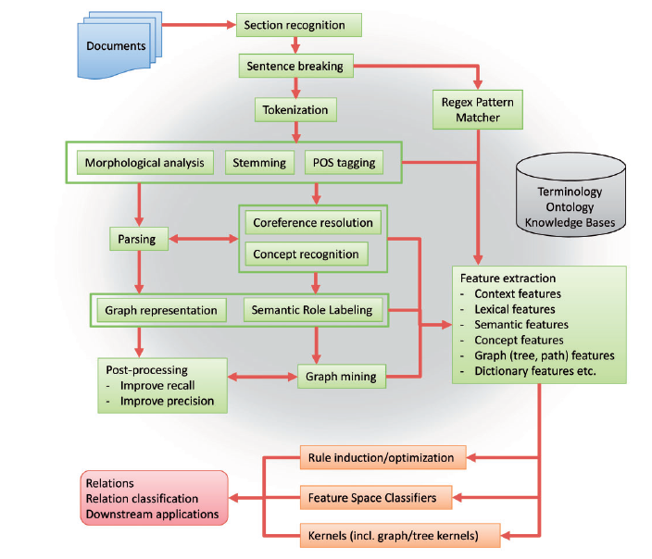
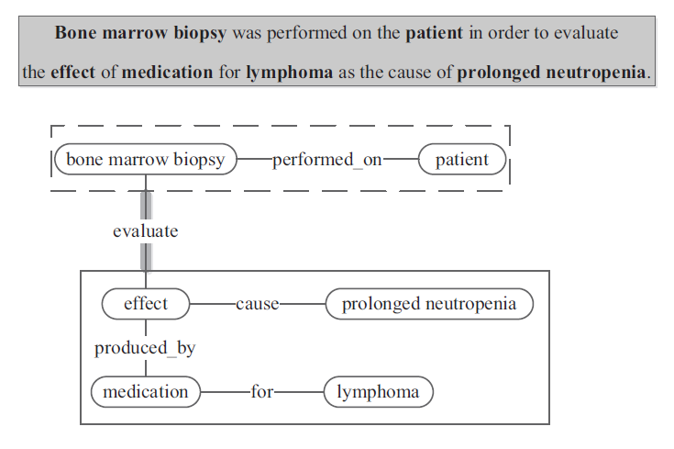
General pipeline for biomedical relation extraction

Slide 3
Relation extraction from the scientific literature - Pharmacogenomics
numerous efforts have centered on the utilization of literature and clinical text to mine interesting relations between genetic mutations and drug response phenotypes.
Although it is difficult to compare their performances.
because the experiments are not on shared corpora.
these approaches do illuminate the translational application and adaptation of some state-of-the-art biomedical relation extraction techniques to problems directly asked by clinicians and pharmacologists.

Slide 4
Relation extraction from the scientific literature - Pharmacogenomics
Some systems used path-based approaches.
Coulet et al.
aimed at extracting binary relations between genes, drugs and phenotypes to build semantic networks for pharmacogenomics.
They first converted the Stanford Parser output on sentences (from collected PubMed abstracts) into dependency graphs.
They tracked the paths starting from named entities and ending at a verb, and merged paths ending with the same verb to form binary relations. Coulet et al. retained frequent relations and normalized both the collected entities and relation types (verbs). Without requiring prior enumeration of relation types, they created a semantic network knowledge base from 17 million MEDLINE abstracts, providing semantically rich summaries of pharmacogenomics relations
Percha et al.
Extended this approach to use breadth-first search to yield the shortest path between two named entities in the dependency graph to generate features for relation extraction.
They combined the extracted gene–drug relations to infer DDIs for those drugs that interact with the same gene product.
Wang et al.
Used Latent Dirichl et al. location to create a semantic representation of biomedical named entities and used Kullback-Leibler (KL) divergence to calculate the association distance between pairs of entities in the Chem2Bio2RDF [149] semantic network.
They ranked candidate associations between named entity pairs by summing distances along the path connecting the pairs.
They demonstrated uses cases on novel knowledge discovery including searching and predicting novel gene–drug associations, traversing the mined semantic network to compare the molecular therapeutic and toxicological profiles of candidate drugs.

Slide 5
Relation extraction from the scientific literature - Pharmacogenomics
Other systems used tree-based approaches.
Katrenko et al.
studied gene–protein relation and protein–protein relation extraction and included as features the subtrees rooted at the lowest common ancestors of two named entities in the dependency parse trees.
Their experiment used several parsers including the Link Grammar Parser , Minipar and the Charniak Parser.
Compared with individual parser’s results separately, they reported improved performance from adopting ensemble methods (stacking and AdaBoost) and combining multiple parsers’ results.
Hakenberg et al.
aimed at extracting relations among genes, single-nucleotide polymorphism variants, drugs, ADRs. They relied on co-occurrence for extraction of certain relations
(e.g. gene–drug, gene–disease and drug–disease), but augmented co-occurrence with subtrees from the Stanford Parser output for other types of relations.
They considered binary relations and used subtrees rooted at the lowest common ancestors of named entity pairs.
The mined relations are cross-referenced with knowledge bases including EntrezGene , PharmGKB and PubChem.
Bui et al.
aimed at extracting relations between drugs and virus mutations from the literature to predict HIV drug resistance.
They used Stanford Parser to generate constituent parse trees for sentences and developed grammatical rules that traverse the tree structures to extract drug–gene relations.
Their system is in research use at five hospitals to preselect novel HIV drug resistance candidates.

Slide 6
Relation extraction from the scientific literature - Pharmacogenomics
Both path-based and tree-based systems in pharmacogenomics tend to focus on precision over recall in their evaluation, differing from the balanced f-measure used in multiple shared tasks.
This likely stems from their specific goals of harvesting reliable relations to build and grow pharmacogenomics semantic networks.
Too much noise will likely cloud the initial semantic network, while missing relations still have a chance to be later discovered with growing literature.
In fact, reported precisions for pharmacogenomics relation extraction systems typically range from 70% to >80%.
In addition, these systems often check extracted relations against curated database such as PharmGKB.
We believe that these systems can further benefit from adopting parsers trained with biomedical models and using enriched graph-based features, two of the most recent lessons learned in shared tasks.

Slide 7
Relation extraction from the scientific literature - Pharmacogenomics
The medical informatics community has also extensively studied relation extraction in the form of shared tasks and separately motivated research.
This likely stems from their specific goals of harvesting reliable relations to build and grow pharmacogenomics semantic networks.
Too much noise will likely cloud the initial semantic network, while missing relations still have a chance to be later discovered with growing literature.
In fact, reported precisions for pharmacogenomics relation extraction systems typically range from 70% to >80%. In addition, these systems often check extracted relations against curated database such as PharmGKB.
We believe that these systems can further benefit from adopting parsers trained with biomedical models and using enriched graph-based features, two of the most recent lessons learned in shared tasks.

Slide 8
Relation extraction from the scientific literature - Relation extraction from clinical narrative text
The challenge had three tasks including concept extraction, assertion classification and relation classification, participated by numerous international teams.
Concept extraction can be considered the basic task, as assertions and relations all refer to the extracted concepts.
As the challenge allows relation classification to use the ground truth of concepts extraction, the performance metrics for relation classification should be interpreted as an upper bound for the end-to-end relation extraction task
(same as the challenges from BioNLP, BioCreative and DDIExtraction).
In this section, we review only the relation classification systems, where the target relations are predefined among medical problems, tests and treatments.
These relations include
‘treatment improves / worsens / causes / is administered for / is not administered because of medical problem’, ‘test reveals / conducted to investigate medical problem’ and ‘medical problem indicates medical problem’.
As in reviewing the above challenges, we review only those systems that represented sentences as graphs and explored such graphs during the feature-generation step.

Slide 9
Relation extraction from the scientific literature - Relation extraction from clinical narrative text
Roberts et al.
classified the semantic relations using a rather comprehensive set of features:
context features (e.g. n-grams, GENIA part-of-speech tags surrounding medical concepts),
nested relation features (relations in the text span between candidate pairs of concepts),
single concept features(e.g. covered words and concept types),
Wikipedia features (e.g. concepts matching Wikipedia titles),
concept bi-grams features and
similarity features.
The latter were computed using edit distance on language constructs including GENIA phrase chunks and Stanford Dependency shortest paths.
Their system reached the highest f-measure on relation classification (0.737).
deBruijn et al.
applied a maximum entropy classifier with down sampling applied to balance the relation distribution.
They applied the McClosky-Charniak-Johnson parser/Stanford Dependency pipeline, and included as features the dependency paths between the minimal trees that cover the concept pairs.
They used word clusters as features to address the problem of unseen words. Their system reached the second best f-measure of 0.731.
Solt et al.
then experimented with several parsers including the Stanford Parser, the McClosky-Charniak-Johnson Parser and the Enju Parser.
They used the resulting dependency graphs with two graph kernels including the all paths graph (APG) kernel [20] and kBSPS [99], which produced only moderate performance.
This likely reflects the difficulty in tuning the graph/tree kernel-based systems, consistent with the observations from the experience in relation/event extraction from the scientific literature.

Slide 10
Relation extraction from the scientific literature - SemEval 2015 Task 14
The SemEval 2015 Task 14 included
disorder identification
disorder slot filling tasks.
Disorder identification is essentially named entity detection
Disorder slot filling is similar to BioNLP event extraction tasks but in clinical subdomain.
The challenge further divided the slot filling task into two subtasks,
one with gold-standard disorder spans (task 2a)
one without (task 2b).
Thus, task 2b has stricter evaluation results than task 2a.
The attribute slots defined by the challenge include
concept unique identifier (CUI) negation (NEG), subject (SUB), uncertainty (UNC), course (COU), severity (SEV), conditional (CND), generic (GEN) and body location (BL).
Identifying the CUI is the named entity-detection problem, and identifying negation and uncertainty is the assertion classification problem.
Identifying SUB, COU, SEV, CND, GEN and BL are more analogous to binary relation extraction.
They are not completely equivalent to binary relation extraction, as the challenge limited the possible values for those slots, adding a layer of abstraction.

Slide 11
Relation extraction from the scientific literature - SemEval 2015 Task 14
The challenge used weighted accuracy to rank the participants. Xu et al. [97] and Pathak et al. [98] consistently ranked as the top two teams in both task 2a (0.886 and 0.880, respectively)and task 2b (0.808 and 0.795, respectively).
Xu et al.
used Conditional Random Field (CRF) as the classifier for BL slot filling and SVM as the classifier for the other slots.
The SVM classifier additionally used dependencies coming into and out of the disorder mentions.
Note that these dependencies cannot capture multi-hop syntax dependence, but the authors observed that NEG/UNC/COU/SEV/GEN always have one-hop dependence.
On the other hand, CRF (for BL) is itself a graph-based model that treats tokens and hidden states as nodes (integrating semantic and syntactic features including n-grams, context words, dictionaries and section names) and interconnects
nodes with transition and emission edges.
Pathak et al.
divided slot detection into two parts: detecting keywords and relating keywords with disorder mentions.
They used dictionary look-up combined with CRF trained on features such as bag-forwords and orthographic features to detect keywords.
To relate keyword with disorder mentions, they trained SVM using features similar to Xu et al. plus Part-of-Speech tags.
Other teams used explicit graph-mining algorithms and but did not perform as competitively.
For example,
Hakala et al.
tackled task 2a by adapting TEES system to work with SemEval data format and achieved a weighted accuracy of 0.857, placing the third.
This is not surprising, as given many slots only involve one-hop dependencies, full-fledged graph-based approach only offers limited benefits.
In addition, the controlled vocabulary and controlled format nature of challenge tasks makes themselves suitable for CRF, as limited number of states and state-transitions lead to less sparse and more robust probability estimation.

Slide 12
Relation extraction from the scientific literature - Separately motivated clinical relation extraction
After the i2b2 challenges,
several authors aimed at combining the concept and relation extraction steps into an integral pipeline and/or generalizing to the extraction of complex or even nested relations.
Xu et al.
developed a rule-based system MedEx to extract medications and specific relations between medications and their associated strengths, routes and frequencies.
The MedEx system converts narrative sentences in clinical notes into conceptual graph representations of medication relations.
To do so, Xu et al. designed a semantic grammar directly mappable to conceptual graphs and applied the Kay Chart Parser to parse sentences according to this grammar.
They also used a regular-expression-based chunker to capture medications missed by the Kay Chart Parser.
Weng et al.
applied a customized syntactic parser on text specifying clinical eligibility criteria.
They mined maximal frequent subtree patterns and manually aggregated and enriched them with the UMLS to form a semantic representation for eligibility criteria, which aims to enable semantically meaningful search queries over ClinicalTrials.gov.
Luo et al.
augmented the Stanford Parser with UMLS-based concept recognition to accurately generate graph representations for sentences in pathology reports where the graph nodes correspond to medical concepts.
Frequent subgraph mining was then used to collect important semantic relations between medical concepts (e.g. which antigens are expressed on neoplastic lymphoid cells), which serve as the basis for classifying lymphoma subtypes. Extending the
subgraph-based feature generation into unsupervised learning, Luo et al. [50] further used tensor factorization to group subgraphs.
The intuition is that each subgraph corresponds to a test result, and a subgraph group represents a panel of test results, as typically used in diagnostic guidelines.
The tensors incorporated three dimensions: patients, common subgraphs and individual words in each report.
The words helped better group subgraphs to recover lymphoma subtype diagnosticcriteria.

Slide 13
Relation extraction from the scientific literature - Shared resources for relation extraction
The shared tasks and separately motivated research on biomedical relation extraction have not only advanced the stateof-the-art in methodology, but also created and/or demonstrated the utilization of a repository of shared resources that range from knowledge bases to shared corpora to graph mining toolkits.
We categorize and summarize those resources in Table 3, in the hope that it may serve as a starting point for resource navigation for future research efforts.
Some of those resources concern general domain
(e.g. general terminology/ontology resources Wordnet , Verbnet);
some concern the biomedical domain comprehensively
(e.g. domain-specific terminology/ontology resources Gene Ontology , UMLS , Medical Subject Heading and Biothesaurus );
some target-specific biomedical subdomain
(e.g. knowledge bases such as PDB , Uniprot , SIDER , DrugBank , HIVDB , RegaDB , Entrez Gene , GENA and IntAct ).

Slide 14
Relation extraction from the scientific literature - The road ahead
Although notable progress has taken place in applying graph-based algorithms to improve the extraction of biomedical relations, barriers still exist to developing practical relation extraction methods that are both generalizable and sufficiently accurate. Below we discuss a few such barriers and potential directions to overcome them.

Slide 15
Relation extraction from the scientific literature - Not all parsers and dependency encodings are synergistic
It has been pointed out repeatedly that the choice of the parser and dependency encodings may play an important role in a relation extraction system’s performance.
Buyko et al.
performed comparative analysis on the impact of graph encoding based on different parsers
(Charniak-Johnson [112], McClosky-Charniak-Johnson, Bikel [175], GDep, MST [119], MALT [178]) and
dependency representations (Stanford Dependency and CoNLL dependency) and
found that the CoNLL dependency representation performs better in combination with four parsers than the Stanford Dependency representation;
and McClosky-Charniak-Johnson parser frequently places as the best performing parser.
Miwa et al.
compared five syntactic parsers for BioNLP-ST-2009.
They concluded that although performances from using individual parsers
(GDep, C&C [176], McClosky-Charniak-Johnson, Bikel, Enju) do not differ much, using an ensemble of parsers and different dependency representations (Stanford Dependency, CoNLL, Predicate Argument Structure) can improve the event extraction results. As Stanford Dependency is the most widely used dependency encoding, they also compared the performance of using different Stanford Dependencyvariants and found that basic dependency performs best if keeping types of dependency edges.
On the other hand, if ignoring types of dependency edges, they found that the collapsed dependency variant performs best, which corroborates the finding by Luo et al. [49].
In [49], the task is extracting relations as features to classify lymphoma subtypes instead of classifying relations themselves as in supervised relation classification in the BioNLP-ST event extraction tasks.
Thus, recall is favored in the feature learning step, where ignoring types of dependencies helps to improve the coverage of subgraph patterns.
The lessons learned in [49, 177, 179] seem to corroborate individual reports from top participants from challenges and are consistent with the popularity of parser-dependency choice from nonchallenge applications in sections Pharmacogenomics and Separately motivated clinical relation extraction.
In particular, we expect a good combination is to choose from either the McClosky-Charniak-Johnson parser or Stanford parser augmented
with medical lexicon and choose from either CoNLL dependency or collapsed Stanford dependency.

Slide 16
Relation extraction from the scientific literature - Integrating coreference resolution
Coreference occurs frequently in biomedical literature and clinical narrative text, arising from the use of pronouns, anaphora and varied entities for the same concepts.
Care must be exercised to transfer the correct relation along the coreference chain.
However, many of the reviewed approaches for relation and event extraction did not have a built-in coreference resolution component.
Miwa et al.
specifically studied the impact of using a coreference resolution system and showed improved event extraction performance.
In particular, they developed a rule-based coreference resolution system that consists of detecting rules for mention, antecedent and coreferential link.
They used the coreference information tomodify syntactic parse results so that antecedent and mention share dependencies.
Features were also extended between mentions and antecedents.
Recognizing the importance of coreference features, several systems [181–184] subsequently implemented coreference resolution across sentences.
They showed that to facilitate extracting specific types of relations, heuristic/rule-based coreference resolution tends to outperform domain-adapted statistical machine learning systems.
Part of their lessons concerns the lack of gold-standard coreference annotation in relation extraction corpora;
thus, we expect that paired relation and coreference annotations can improve coreference resolution and ultimately relation extraction.
Moreover, integrating coreference resolution into the learning objective of relation extraction may lead to more coherent optimization and better end-to-end performance.

Slide 17
Relation extraction from the scientific literature - General relation and event extraction and domain adaptation
The state-of-the-art relation and event extraction systems from shared tasks are mostly built around domain-specific definitions of relations and events,
many of which are in fact binary
(e.g. BioCreative PPI challenge , DDIExtraction challenge and i2b2/VA challenge ).
However, there is a gap between the technical advances and the demands from many real-world tasks, including building pharmacogenomics semantic networks , extracting clinical trial eligibility criteria and representing test results for automating diagnosis categorization.
In those tasks, general relation and event discovery is necessary, where the number of nodes is flexible and even the relation/event structure may not be entirely prespecified.
Systems exploring the automation of annotation scheme learning or unsupervised relation extraction attempted to enable generalization but there is still large room for improving accuracy.
Another challenge brought by domainspecific relation/event definition concerns the training data.
The problem of limited training data often plagues the development of NLP systems, among which the relation extraction systems are no exceptions.
To make better use of existing annotated corpora, it is necessary to perform domain adaptation from external training corpora (source) to the target corpora.
Merely adapting top systems to the new format and training on the new corpora does not always lead to top performers in the new domains, e.g. the adapted TEES system in SemEval 2015 Task 14.
Miwa et al.
proposed adding source instances followed by instance reweighting when source and target match on events to be extracted.
When source and target corpora have a partial match on events, they proposed to train each event extraction module separately on the source corpora and used its output as additional features for the corresponding modules on the target corpora.
Miwa et al. [185] further improved methods of combining corpora by integrating heuristics to filter spurious negative examples.
The heuristics aim to correct errors where instances with a ‘None’ annotation in one corpus owing to a different focus are all treated as negative instances in the combined corpus.
Applying this method on learning from seven event-annotated corpora, they showed improved performance on two tasks in BioNLP-ST-2011.
The successes from cascaded training and example filtering heuristics illuminate some promising directions in corpora adaptation.
We expect parallel efforts in system generalization and corpora adaptation can complement each other toward effective domain adaptation.

Slide 18
Relation extraction from the scientific literature - Redundancy in subgraph patterns
Detection of useful subgraph patterns often depends on identifying ones with high frequency. A subgraph occurs once in a corpus whenever it is part of a larger graph in that corpus.
Frequent subgraph mining identifies those subgraphs that occur in a corpus more than a given threshold number of times
(see [186] for a survey on frequent subgraph mining and see [170–174] for various software).
Lessons learned in multiple studies [49, 64, 65, 184] showed that redundancy among collected subgraph patterns creates problems when using subgraphs as features.
Many smaller subgraphs are subisomorphic to (part of) other larger frequent subgraphs.
Many of these larger subgraphs have the same frequency as their subisomorphic smaller subgraphs.
This arises when a larger subgraph is frequent, and therefore all its subgraphs automatically become frequent as well.
Furthermore, if the smaller subgraph gs is so unique that it is not subisomorphic to any other larger subgraph than gl, then this pair gs, gl shares identical frequency.
Based on such observations,
Luo et al.
only kept the larger subgraphs in such pairs.
Note that it is cost prohibitive to perform a full pairwise check because the subisomorphism comparison between each subgraph pair is NP-complete , and a pairwise approach would ask for around a billion comparisons for a collection of several tens of thousands of subgraphs.
Luo et al. presented an efficient algorithm using hierarchical hash partitioning that reduces the number of subgraph pairs to compare by several orders of magnitude.
The key idea is that one only needs to compare subgraphs whose sizes differ by one, and one can further partition the subgraphs so that only those within the same partition need to be compared.
The frequent subgraph redundancy is a systemic problem and is also closely related to the problem of nested terms in automatic term extraction, and a variety of de-duplicating scores (e.g. c-value [187]) proposed
for the latter problem could be adapted to address the former problem. Other graph mining approaches may also be applicable, depending on the task.
For example, algorithms may be developed to collect subgraph patterns that explore the ‘novelty’ of the subgraphs, such as using p-significance to assess how unusual it is to see the subgraphs in the current corpus

Slide 19
Relation extraction from the scientific literature - Integrating with NER
Most shared task participants were not evaluated based on their relation extraction from scratch. Rather, their systems were evaluated given the gold standard of named entity annotations,which is even true for challenges that include a NER task, such as the i2b2/VA shared tasks.
Thus, their evaluation results are likely an upper bound of the end-to-end system performance, the tuning of which is in fact a non-trivial task.
Kabiljo et al.
evaluated several methods for end-to-end relation extraction including a keyword-based method, a co-occurrence-based method and a method using dependency-graph-based patterns.
They noted that in general a significant performance drop will occur when using named entities tagged by NER system such as BANNER instead of using the gold standard. In addition, it is useful but challenging to filter out un-related named entity pairs, for which no relations have been explicitly stated in the text .
Such filtering may adopt a hybrid approach that relies on both automatically checking semantic type compatibility and manually sifting through the remaining tuples.
However, as the number of non-related tuples often dominates that of related tuples, better automated filtering is necessary and remains an open question.
Latest challenges such as SemEval 2015 Task 14 added the end-to-end evaluation on joint detection/ inference of entities and relations for prespecified relations, and it is reasonable to expect such evaluation will become more popular and will boost the development of end-to-end systems.

Slide 20
Relation extraction from the scientific literature - Integrating with NER
Relation extraction currently concentrates a large amount of efforts in biomedical information extraction.
In the future, we anticipate a migration toward more unsupervised relation extraction that are increasingly adaptable across biomedical subdomains.
The integration of relation extraction with named entity detection will produce end-to-end systems that can further automate the discovery and curation of novel biomedical knowledge.
With advances in deriving better graph representations with more accurate parsers and appropriate dependency choices, in enhancing coreference resolution at document level, and in more efficiently sifting through informative subgraph patterns, the extraction of biomedical relations will continue to improve owing to an increase in the quality of data, and sustained community efforts.
Given the rapid progress in the past years, we expect more exciting and promising developments of biomedical relation extraction, which continuously shape the emerging landscape and provide opportunities for researchers to contribute.

